Slide 1
SHEA Spring 2024 Data Visualization Demo
Matthew Ziegler

Slide 2
Overview
A rapid overview of R
Importing and manipulating data
Visualizing data

Slide 3
R Introduction
R is a programming language useful for
data
data visualization
statistics
Typically used with a software interface
RStudio
VScode
Community derived “packages”
Resources: R for Data Science https://r4ds.had.co.nz

Slide 4
R Introduction
Why use a code-based approach to data manipulation?
Reproducible
Easy to share
Infinitely modifiable

Slide 5
R Introduction
Download and install R
Download and install R Studio (or alternative)
Run scripts
R Script
R Markdown
Version control and collaboration via Github

Slide 6
Getting Started
Let’s load some packages
“tidyverse” is an open source collection of packages for working with data
“dplyr” is a set of functions for data manipulation -“ggplot2” is a system for creating graphics
library(dplyr) library(ggplot2) library(gt)

Slide 7
Piping Data
Imagine your data is water
Through a series of pipes ( %>% ) you can
transform your data
feed data to generate different products
data %>% new_data %>% tables
data %>% different_data %>% figures

Slide 8
Loading our Data
Loading example data from CDC HAIC-Viz
dat_cdiff <- read.csv("/Users/mattz/Documents/GitHub/shea24_demo/HAICViz_-_CDI_20240214.csv") %>% janitor::clean_names() %>% filter(topic =="Case rates (cases per 100,000)", series =="Community-associated"|series=="Healthcare-associated")
head(dat_cdiff) %>% gt()

Slide 9
Let’s do a simple graph
Start with your data
Pipe your data to ggplot - ggpplot()
Define the aesthetics either globally or individually by plot - aes()
Add your plots and labels - geom_line() + labs()
dat_cdiff_line_plot <- dat_cdiff %>% ggplot(aes(x = as.factor(year_name), y = value, group = series)) + geom_line(aes(linetype = series)) + labs(title = "Cases by year", y = "CDI cases per 1000 individuals", x = "Year")

Slide 10
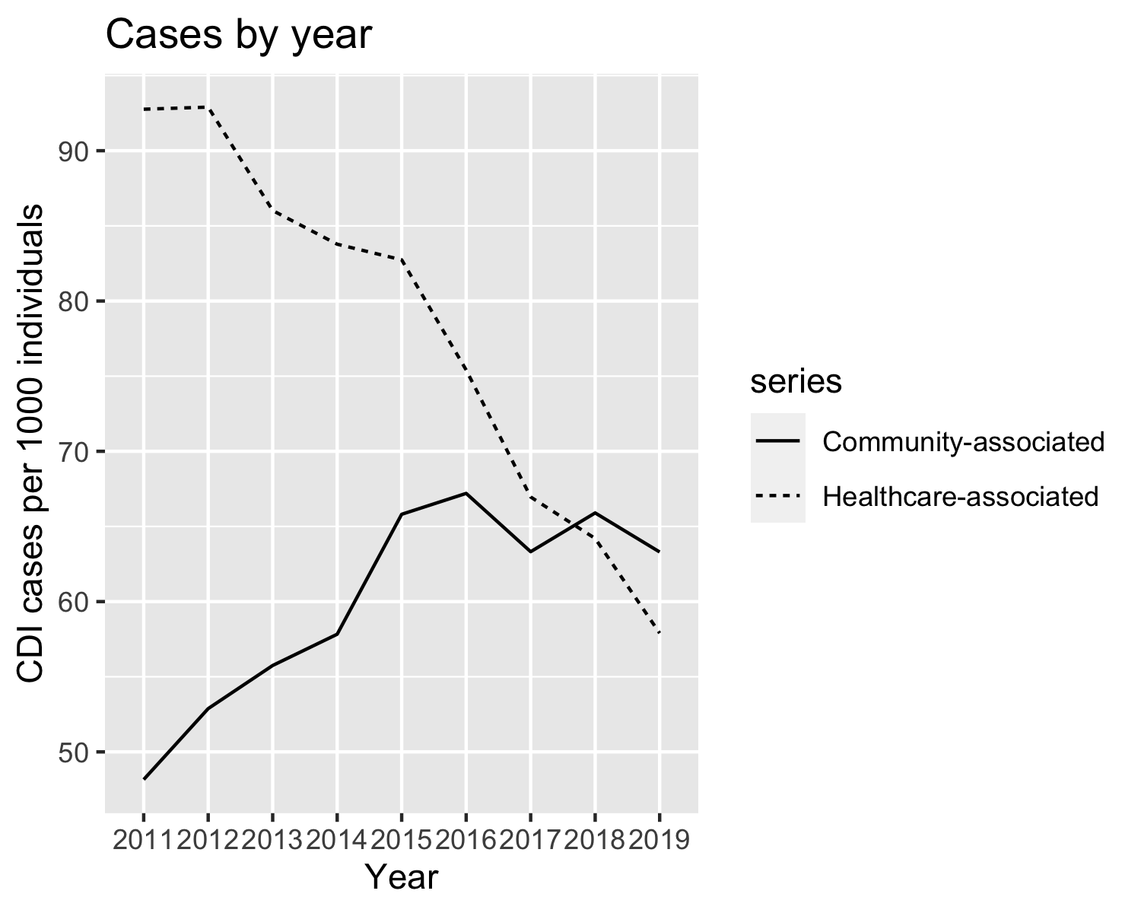
Let’s do a simple graph

Slide 11
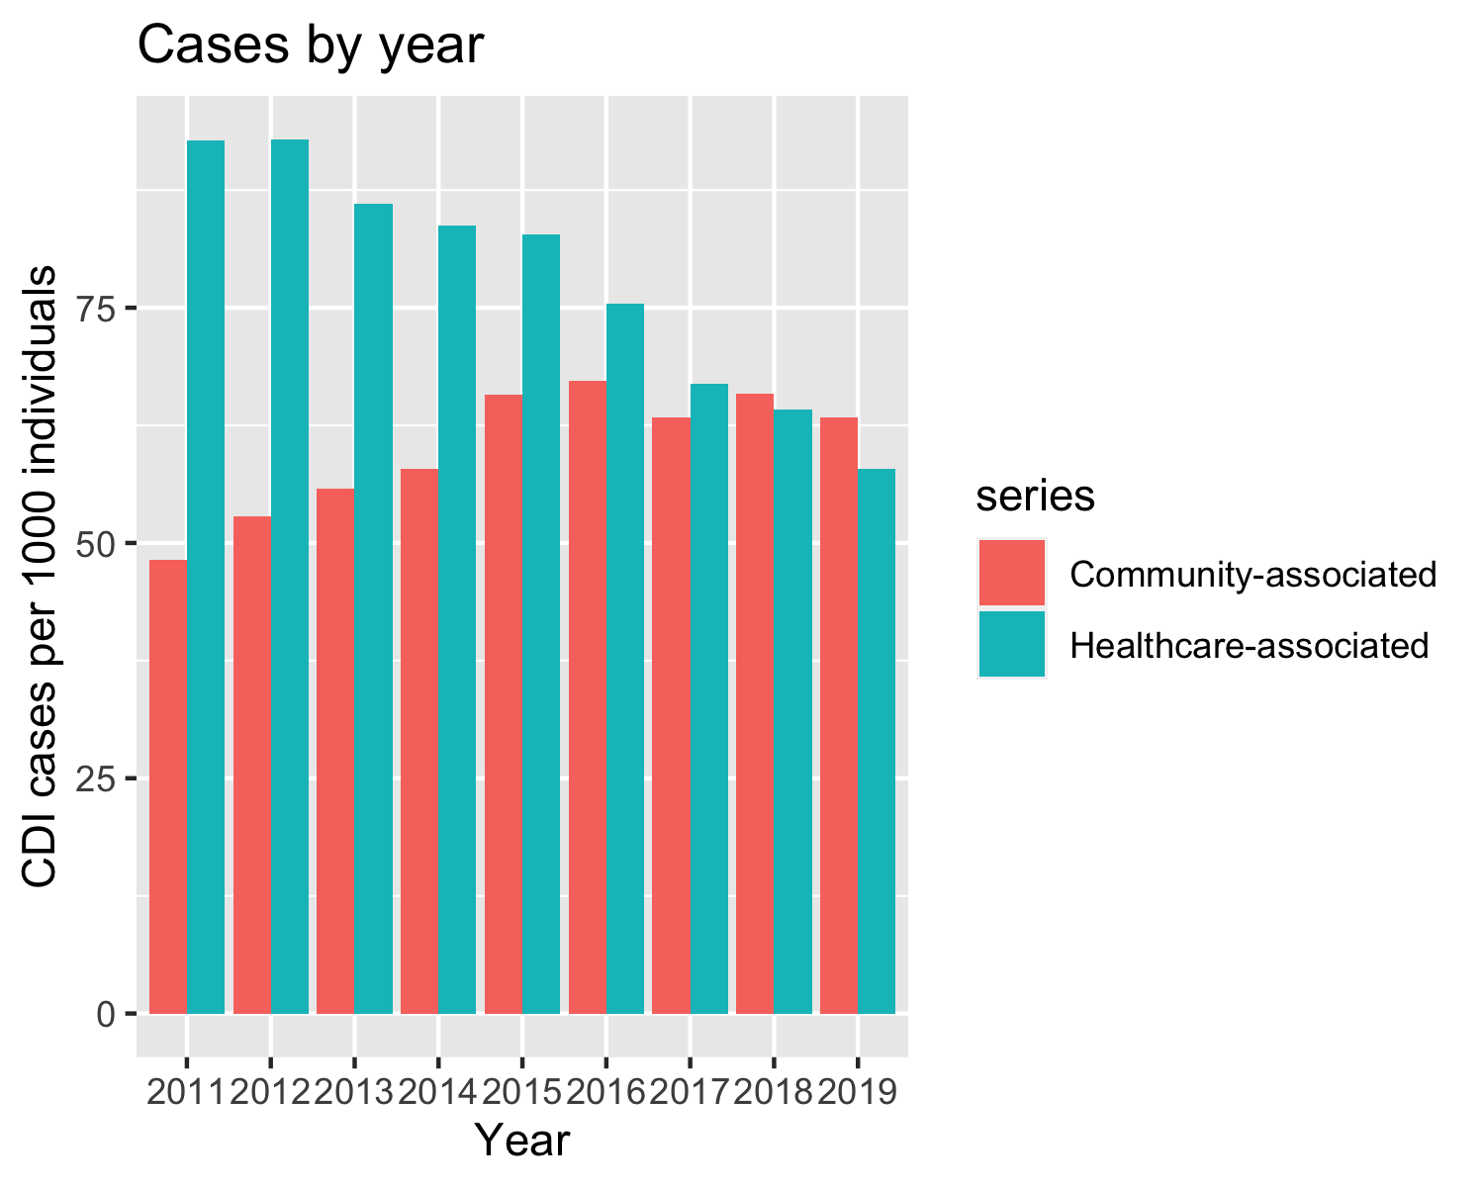
Let’s do a simple graph
Don’t like lines? - https://ggplot2.tidyverse.org/reference/
dat_cdiff %>% ggplot(aes(x = as.factor(year_name), y = value, fill= series)) + geom_col(position = "dodge") + labs(title = "Cases by year", y = "CDI cases per 1000 individuals", x = "Year")

Slide 12
A little more complicated
library(tidyr)
dat_cdiff_cat_plot <- read.csv("/Users/mattz/Documents/GitHub/shea24_demo/HAICViz_-_CDI_20240214.csv") %>% janitor::clean_names() %>% filter(topic =="Case rates (cases per 100,000)") %>% mutate(cat = case_when( grepl("HA|CA", series) ==TRUE & grepl("years", series) ==TRUE ~ "age", grepl("Male|Female", series) ==TRUE & grepl("HA|CA", series) ==TRUE ~ "sex", grepl("White|Non-white", series) ==TRUE & grepl("HA|CA", series) ==TRUE ~ "race")) %>% filter(!is.na(cat)) %>% separate(series, into = c("category","group"), sep =" - ") %>% ggplot(aes(x = as.factor(year_name), y = value, group = interaction(group, category),linetype = category, col = group,)) + geom_line(lwd =1) + theme_minimal() + theme(axis.text.x = element_text(angle = 75, vjust = 0, hjust=0)) + facet_wrap(vars(cat)) + labs(title = "C.difficile Infection by Year", y = "Case rates (cases per 100,000)", x = "Year")

Slide 13
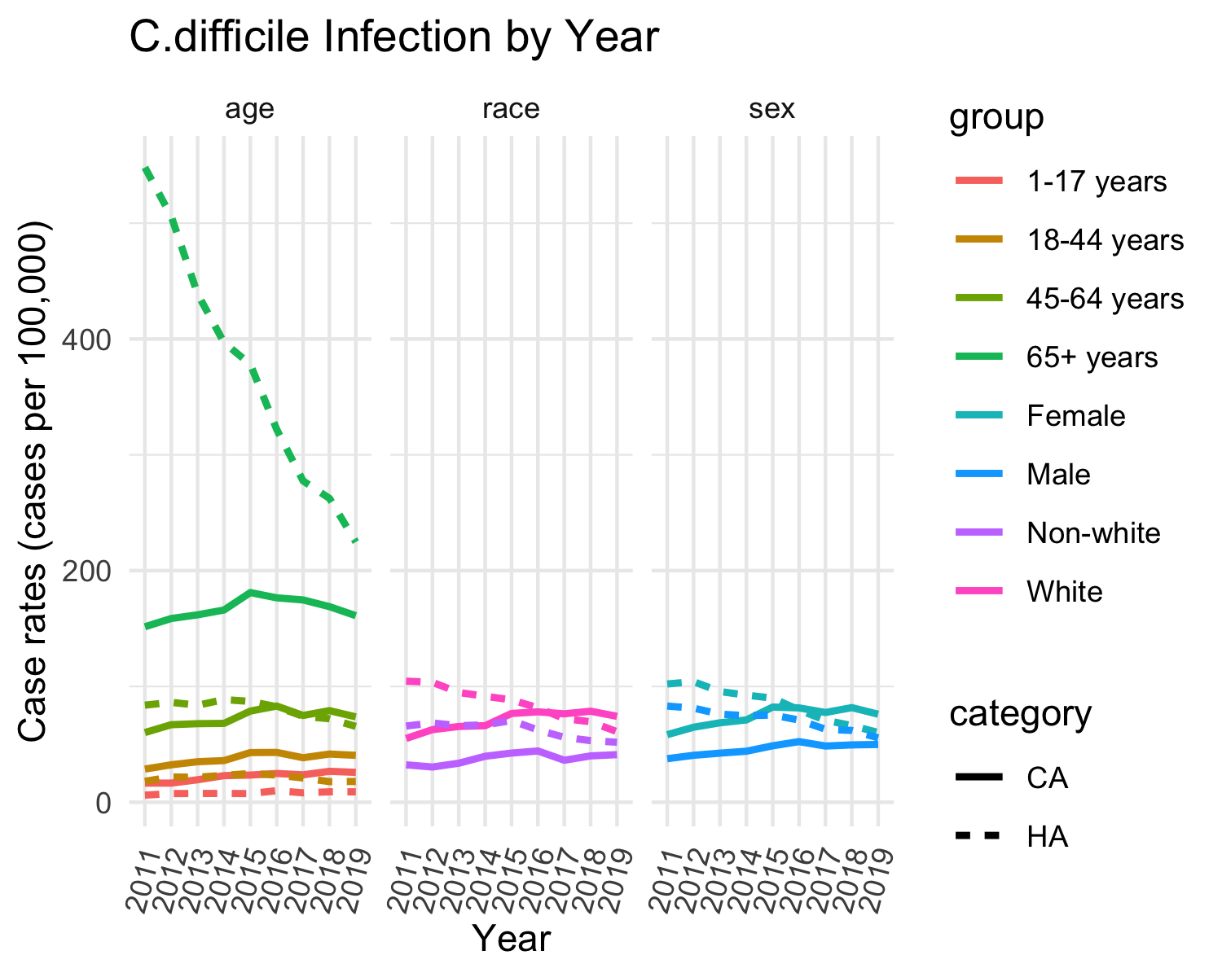
A little more complicated
dat_cdiff_cat_plot

Slide 14
Highlighting and annotating
library(gghighlight)
dat_mdrgn <- read.csv("/Users/mattz/Documents/GitHub/shea24_demo/HAICViz_-_MuGSI_20240330.csv") %>% janitor::clean_names() %>% mutate(keep = case_when( viewby =="Organism" & series != "All cases" ~ 1, organism =="CRAB" & viewby == "All cases" & topic =="Case Rates" ~ 1, TRUE ~ 0 )) %>% filter(keep ==1) %>% mutate(series = ifelse(organism =="CRAB","Acinetobacter baumanii", series))
dat_mdrgn_plot <- dat_mdrgn %>% ggplot(aes(x = as.factor(year_name), y = value, group = series)) + geom_line(aes(linetype = series)) + theme(axis.text.x = element_text(angle = 75, vjust = 0, hjust=0)) + labs(title = "Cases by year - Carbapenem-Resistant GNB", y = "Cases per 1000 individuals", x = "Year") + gghighlight(series =="Acinetobacter baumanii") + theme_minimal()

Slide 15
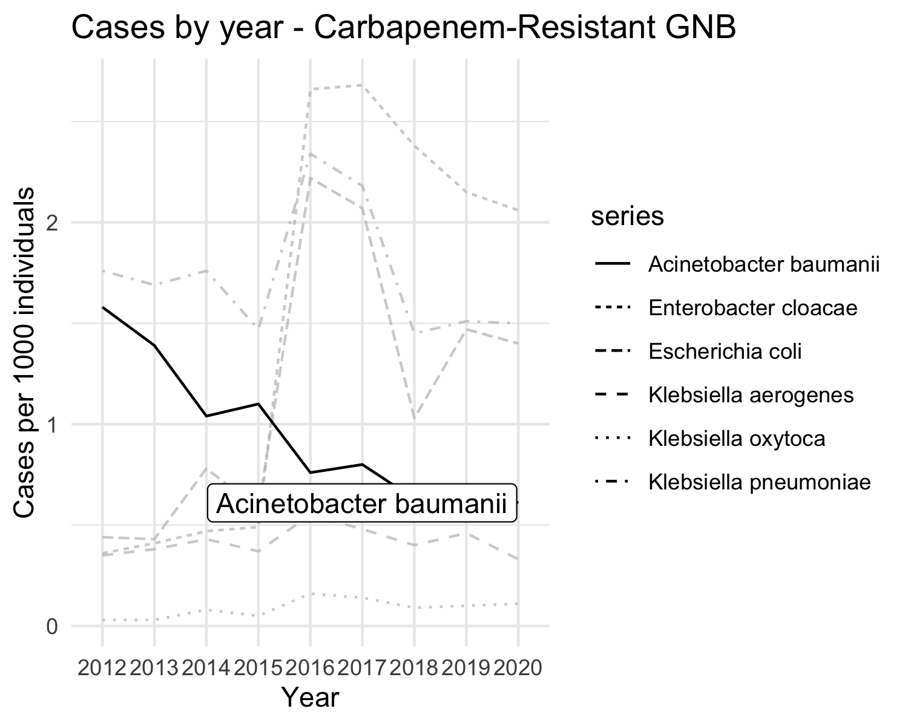

Slide 16
Animated figures
library(magick) library(gganimate) library(maps) library(tidyr)
respi <- read.csv("/Users/mattz/Documents/GitHub/shea24_demo/Outpatient_Respiratory_Illness_Activity_Map_20240401.csv") %>% janitor::clean_names() %>% mutate(region = tolower(state)) %>% separate(activity_level, into=c(NA, "level"), sep = " ") %>% mutate(level = as.numeric(level)) %>% filter(season =="2022-2023") states <- map_data("state")
region_dat_respi <- left_join(states, respi, by = "region")
gif_a <- region_dat_respi %>% ggplot(., aes(long, lat, group = group)) + geom_polygon(aes(fill = level), colour = alpha("white", 1/2), size = 0.05) + geom_polygon(data = states, colour = "black", fill = NA) + scale_fill_gradientn(colours = terrain.colors(6)) + theme_void() + transition_time(week) + labs(title = 'Respiratory Infection Activity 22-23 Season: Week {frame_time}') + theme_minimal() gif_a <- animate(gif_a, width = 700, height = 480)

Slide 17
Animate
gif_b <- region_dat_respi %>% #filter(!is.na(value)) %>% ggplot(data = ., aes(y = level)) + geom_boxplot() + labs(x = "", title = "National Value") + theme(axis.text.x = element_blank()) + transition_time(week) #enter_fade() + #exit_shrink() + #ease_aes('sine-in-out') gif_b <- animate(gif_b, width = 600, height = 480)

Slide 18
Animate
a_mgif <- image_read(gif_a) b_mgif <- image_read(gif_b) new_gif <- image_append(c(a_mgif[1], b_mgif[1])) for(i in 1:95){ combined <- image_append(c(a_mgif[i], b_mgif[i])) new_gif <- c(new_gif, combined) }

Slide 19
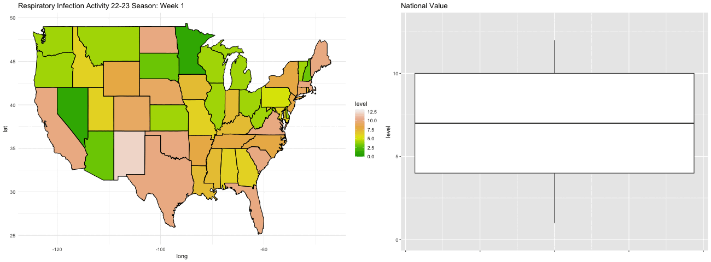

Slide 20
Plotting Model Output
library(gtsummary) library(marginaleffects) latitude_by_states <- states %>% group_by(region) %>% summarise(mean_lat = mean(lat))

Slide 21
Plotting Model Output
vaccination <- read.csv("/Users/mattz/Documents/GitHub/shea24_demo/Vaccination_Coverage_among_Health_Care_Personnel_20240401.csv") %>% janitor::clean_names() %>% mutate(year = as.numeric(substr(season,1,4))) %>% mutate(region = tolower(geography)) %>% left_join(latitude_by_states, by = "region") %>% rename(latitude = mean_lat) %>% filter(personnel_type != "All Health Care Personnel")

Slide 22
Plotting Model Output
model <- lm(estimate ~ year + latitude + personnel_type, dat = vaccination)

Slide 23
Plotting Model Output
tbl_regression(model)

Slide 24
Plotting Model Output
plot_predictions(model, condition = "year") + labs(y = "Estimated Proportion: Vaccine Compliance", x= "Year", title = "Estimated Vaccine Compliance by Year") + theme_minimal()

Slide 25
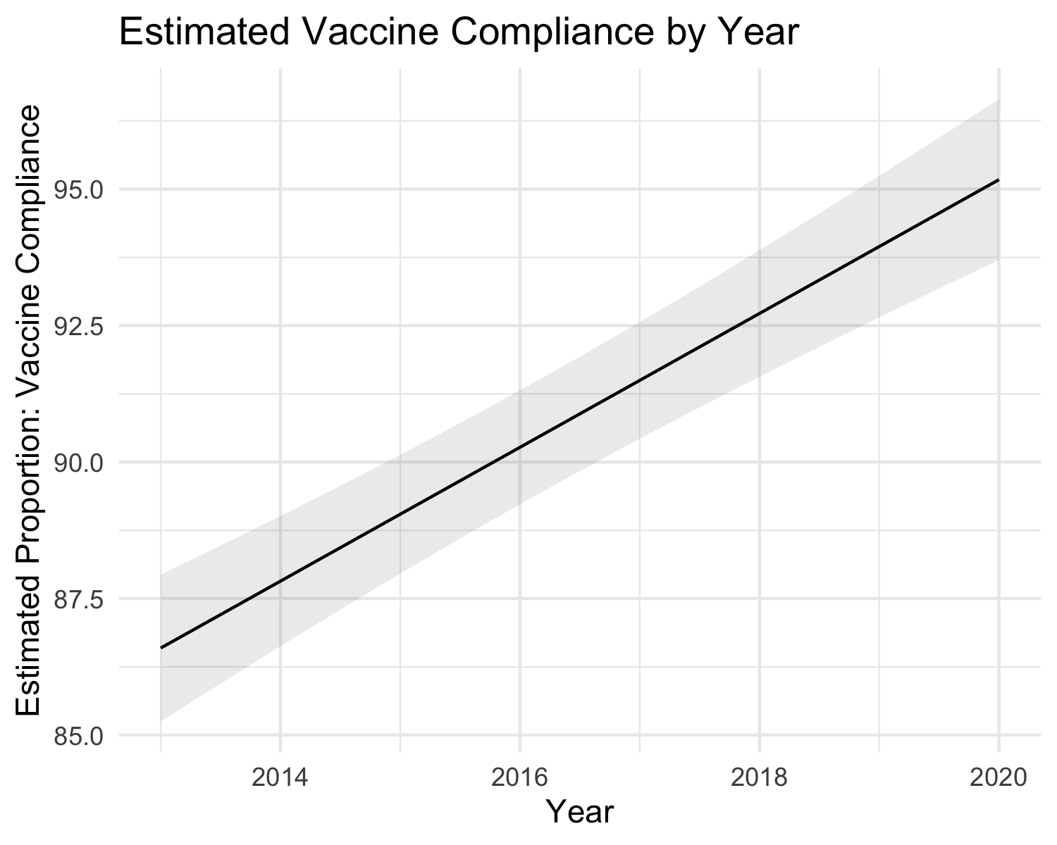
Plotting Model Output

Slide 26
What Else?
Tons of styles, themes, fonts
Combine different plots with patchwork
Creae interactive graphs, hover over to reveal specific information (ggplotly, shiny)
Choose a color pallet from the Metropolitan Museum of Art (metbrewer)

Slide 27
Conclusions
Code-based data manipulations and visualization is highly flexible
Tons of great free-to-use, open-source packages

Slide 28
Resources
Start with the basics (https://r4ds.had.co.nz)
If you have a problem, someone has probably figured it out (https://stackoverflow.com)
Lots of great videos and lectures available
This presentation is available as an RMD file (R MarkDown File)

Slide 29
Citations
https://www.cdc.gov/hai/eip/haicviz.html
#devtools::session_info() citation("base")
## To cite R in publications use: ## ## R Core Team (2023). _R: A Language and Environment for Statistical ## Computing_. R Foundation for Statistical Computing, Vienna, Austria. ## <https://www.R-project.org/>. ## ## A BibTeX entry for LaTeX users is ## ## @Manual{, ## title = {R: A Language and Environment for Statistical Computing}, ## author = {{R Core Team}}, ## organization = {R Foundation for Statistical Computing}, ## address = {Vienna, Austria}, ## year = {2023}, ## url = {https://www.R-project.org/}, ## } ## ## We have invested a lot of time and effort in creating R, please cite it ## when using it for data analysis. See also 'citation("pkgname")' for ## citing R packages.
citation("ggplot2")
## To cite ggplot2 in publications, please use ## ## H. Wickham. ggplot2: Elegant Graphics for Data Analysis. ## Springer-Verlag New York, 2016. ## ## A BibTeX entry for LaTeX users is ## ## @Book{, ## author = {Hadley Wickham}, ## title = {ggplot2: Elegant Graphics for Data Analysis}, ## publisher = {Springer-Verlag New York}, ## year = {2016}, ## isbn = {978-3-319-24277-4}, ## url = {https://ggplot2.tidyverse.org}, ## }
citation("gt")
## To cite package 'gt' in publications use: ## ## Iannone R, Cheng J, Schloerke B, Hughes E, Lauer A, Seo J (2023). ## _gt: Easily Create Presentation-Ready Display Tables_. R package ## version 0.9.0, <https://CRAN.R-project.org/package=gt>. ## ## A BibTeX entry for LaTeX users is ## ## @Manual{, ## title = {gt: Easily Create Presentation-Ready Display Tables}, ## author = {Richard Iannone and Joe Cheng and Barret Schloerke and Ellis Hughes and Alexandra Lauer and JooYoung Seo}, ## year = {2023}, ## note = {R package version 0.9.0}, ## url = {https://CRAN.R-project.org/package=gt}, ## }
citation("dplyr")
## To cite package 'dplyr' in publications use: ## ## Wickham H, François R, Henry L, Müller K, Vaughan D (2023). _dplyr: A ## Grammar of Data Manipulation_. R package version 1.1.2, ## <https://CRAN.R-project.org/package=dplyr>. ## ## A BibTeX entry for LaTeX users is ## ## @Manual{, ## title = {dplyr: A Grammar of Data Manipulation}, ## author = {Hadley Wickham and Romain François and Lionel Henry and Kirill Müller and Davis Vaughan}, ## year = {2023}, ## note = {R package version 1.1.2}, ## url = {https://CRAN.R-project.org/package=dplyr}, ## }
citation("tidyr")
## To cite package 'tidyr' in publications use: ## ## Wickham H, Vaughan D, Girlich M (2023). _tidyr: Tidy Messy Data_. R ## package version 1.3.0, <https://CRAN.R-project.org/package=tidyr>. ## ## A BibTeX entry for LaTeX users is ## ## @Manual{, ## title = {tidyr: Tidy Messy Data}, ## author = {Hadley Wickham and Davis Vaughan and Maximilian Girlich}, ## year = {2023}, ## note = {R package version 1.3.0}, ## url = {https://CRAN.R-project.org/package=tidyr}, ## }
citation("gghighlight")
## To cite package 'gghighlight' in publications use: ## ## Yutani H (2023). _gghighlight: Highlight Lines and Points in ## 'ggplot2'_. R package version 0.4.1, ## <https://CRAN.R-project.org/package=gghighlight>. ## ## A BibTeX entry for LaTeX users is ## ## @Manual{, ## title = {gghighlight: Highlight Lines and Points in 'ggplot2'}, ## author = {Hiroaki Yutani}, ## year = {2023}, ## note = {R package version 0.4.1}, ## url = {https://CRAN.R-project.org/package=gghighlight}, ## }
citation("magick")
## To cite package 'magick' in publications use: ## ## Ooms J (2024). _magick: Advanced Graphics and Image-Processing in R_. ## R package version 2.8.3, <https://CRAN.R-project.org/package=magick>. ## ## A BibTeX entry for LaTeX users is ## ## @Manual{, ## title = {magick: Advanced Graphics and Image-Processing in R}, ## author = {Jeroen Ooms}, ## year = {2024}, ## note = {R package version 2.8.3}, ## url = {https://CRAN.R-project.org/package=magick}, ## }
citation("gganimate")
## To cite package 'gganimate' in publications use: ## ## Pedersen T, Robinson D (2022). _gganimate: A Grammar of Animated ## Graphics_. R package version 1.0.8, ## <https://CRAN.R-project.org/package=gganimate>. ## ## A BibTeX entry for LaTeX users is ## ## @Manual{, ## title = {gganimate: A Grammar of Animated Graphics}, ## author = {Thomas Lin Pedersen and David Robinson}, ## year = {2022}, ## note = {R package version 1.0.8}, ## url = {https://CRAN.R-project.org/package=gganimate}, ## }
citation("maps")
## To cite package 'maps' in publications use: ## ## Becker OScbRA, Minka ARWRvbRBEbTP, Deckmyn. A (2023). _maps: Draw ## Geographical Maps_. R package version 3.4.2, ## <https://CRAN.R-project.org/package=maps>. ## ## A BibTeX entry for LaTeX users is ## ## @Manual{, ## title = {maps: Draw Geographical Maps}, ## author = {Original S code by Richard A. Becker and Allan R. Wilks. R version by Ray Brownrigg. Enhancements by Thomas P Minka and Alex Deckmyn.}, ## year = {2023}, ## note = {R package version 3.4.2}, ## url = {https://CRAN.R-project.org/package=maps}, ## } ## ## ATTENTION: This citation information has been auto-generated from the ## package DESCRIPTION file and may need manual editing, see ## 'help("citation")'.
citation("gtsummary")
## To cite gtsummary in publications use: ## ## Sjoberg DD, Whiting K, Curry M, Lavery JA, Larmarange J. Reproducible ## summary tables with the gtsummary package. The R Journal ## 2021;13:570–80. https://doi.org/10.32614/RJ-2021-053. ## ## A BibTeX entry for LaTeX users is ## ## @Article{gtsummary, ## author = {Daniel D. Sjoberg and Karissa Whiting and Michael Curry and Jessica A. Lavery and Joseph Larmarange}, ## title = {Reproducible Summary Tables with the gtsummary Package}, ## journal = {{The R Journal}}, ## year = {2021}, ## url = {https://doi.org/10.32614/RJ-2021-053}, ## doi = {10.32614/RJ-2021-053}, ## volume = {13}, ## issue = {1}, ## pages = {570-580}, ## }
citation("marginaleffects")
## To cite package 'marginaleffects' in publications use: ## ## Arel-Bundock V (2023). _marginaleffects: Predictions, Comparisons, ## Slopes, Marginal Means, and Hypothesis Tests_. R package version ## 0.13.0, <https://CRAN.R-project.org/package=marginaleffects>. ## ## A BibTeX entry for LaTeX users is ## ## @Manual{, ## title = {marginaleffects: Predictions, Comparisons, Slopes, Marginal Means, and Hypothesis ## Tests}, ## author = {Vincent Arel-Bundock}, ## year = {2023}, ## note = {R package version 0.13.0}, ## url = {https://CRAN.R-project.org/package=marginaleffects}, ## }

